Slide 1
Large Scale Text Analytics Tutorial
David Buttler

Slide 2
Outline
Motivation and scale overview
Large scale data storage systems
Query engines (batch vs real time)
Data analytics
Ongoing research

Slide 3
My motivation: my file system broke
Problem: too many small files
1 million original news articles
Text from each article extracted without markup and meta data
Metadata from each text file
Annotation files for each text file
Paragraph
Sentence
Token
Part-of-speech (POS)
Named entity
Tree parse
Co-reference
More…
What works on MUC / ACE does not work at even moderate scale

Slide 4
What is Big Data? Scale Points
Break point | Data size* | Doc. Count*
Memory of one machine | 128 GB | 5 Million
One disk | 2 TB | 83 Million
Disk attached to one machine | 24 TB | 1 Billion | ClueWeb09 uncompressed
Small cluster (memory) | 1 TB | 42 Million
Large cluster (memory) | 100 TB | 4 Billion
Large cluster (disk) | 2 PB | 400 Billion
small
medium
large
* Size based on ClueWeb 09

Slide 5
Bottlenecks cannot be eliminated, only moved
Match the performance capabilities of your system's components in such a way that no single component is hampering the performance of any other component.
Different workloads lead to different bottlenecks
cannot tune a system to perform well in all situations
Pricing sweet points are changing rapidly (monthly)
http://support.novell.com/techcenter/articles/ana19960104.html

Slide 6
Bottlenecks come in flavors
CPU
Disk
Network
Moving the bottleneck: proportional consumption

Slide 7
Bottlenecks come in flavors: Disk
Disk bottlenecks:
Seeks: 3-15 ms (SSD: 0.1 ms)
Rotational delay: 7200 RPM disk == 8 ms
Transfer delay: 1030 Mbits/sec
Seek performance measured in IOPS
iostat is the measurement tool
Standard HDD: 180 IOPS
Flash SDD: 40K IOPS
http://en.wikipedia.org/wiki/Hard_disk#Performance_characteristics http://highscalability.com/blog/2011/6/22/its-the-fraking-iops-1-ssd-is-44000-iops-hard-drive-is-180.html

Slide 8
Bottlenecks come in flavors: Network
Network bottlenecks:
Network speed (e.g. 1 GigE is 1 Gbit / s )
Network utilization (80% is good for Ethernet)
Packet fragmentation / underutilization
Ethernet frames should be set to 7500 if your network supports jumbo frames
Switch backplane (on-rack and cross-rack)
“Network contention”: heartbeats may be delayed by long queues, leading to “Juliet pauses”
http://www.cloudera.com/blog/2011/02/avoiding-full-gcs-in-hbase-with-memstore-local-allocation-buffers-part-1/

Slide 9
How do you handle data that you can’t back up? Data Replication
RAID
Mirror (redundancy)
Striped (speed)
Checksum / RAID 5 ( accuracy)
ZFS
HDFS
local access
n-way redundancy
MapR FS
HDFS compatible
Distributed metadata
Cluster replication
Master/slave
peer

Slide 10
Storing data is not the same as managing data: Data storage systems
Hadoop / HDFS
HBase
Cassandra
MongoDB
Solr / Elastic Search
Netezza (IBM) / Greenplum (EMC) / Aster Data (TeraData)
MySQL
Oracle

Slide 11
Hadoop (HDFS) as a data storage system
No metadata management – it’s just a file system
Great for large BLOBs of data organized like a file system
Terrible for small files*
Complementary products
Hive: SQL over HDFS files with built-in metadata store
HCatalog: independent version of Hive metadata store for integration with Pig, Hive, Streaming, etc.
Great for M/R scans
Medium-Large data (non-critical data only)
* MapR is a commercial company that offers an HDFS replacement that makes handling of small files less troublesome: http://www.mapr.com

Slide 12
HBase as a data storage system
Has a defined table schema
Great for storing lots of small pieces of data and simple attributes
Okay for storing complex structures in serialized form
Not so good for storing BLOBs*
1 MB seems a good rule-of-thumb limit for cell size
Great for M/R scans
Medium-Large data
* The Lily project offers an open source solution that manages BLOBs transparently in a combination of HDFS and HBase: http://www.lilyproject.org

Slide 13
Cassandra as a data storage solution
Large key-value store
Has a schema
Eventual consistency
P2P architecture
Manages its own files; does not rely on HDFS
DataStax* has a Hadoop distribution with HDFS replaced by Cassandra
No scans available
Medium data
*http://www.datastax.com/

Slide 14
Solr as a data storage engine
Typed schema
Built-in indexing
Sharding is manual
Elastic Search provides automatic shard management
No database guarantees
Small-Medium data (non-critical data only)

Slide 15
MongoDB as a data storage engine
Document orientated
JSON wire format
Indexes fields (individual and compound)
Automatic sharding available (with limits)
Collections (tables) are limited to 256GB in version 1.8 (per shard?)
Not tested beyond 100 shards
No obvious Map/Reduce integration
Data flush interval means you can lose data (durability option)
Small-Medium data (non-critical data only)
http://www.mongodb.org/display/DOCS/Sharding+Introduction
http://www.paperplanes.de/2011/1/10/mongodb_and_data_durability.html

Slide 16
Query Engines
Batch
Powerful, but do not return data quickly
Difficult to keep data updated and efficient
Types of available batch queries:
DB indexes
Hive
Pig
Workflow engines
Decomposes into Map/Reduce jobs with attendant overhead

Slide 17
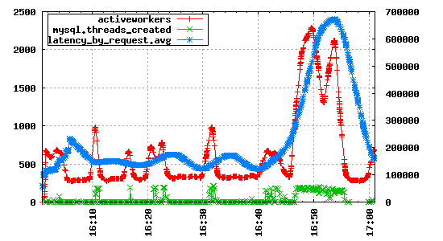
Query Engines: table scans
HBase scans
Can be fast
Limited query semantics
Value comparisons
Boolean
Regex matching
No join
If start and stop rows are not defined, will scan entire table
http://opentsdb.net/
Notes:
Speed depends on query value being part of the key for

Slide 18
Query Engines: Real-time
Not the primary data store, must design architecture to sync data with index
Primary OSS solutions are Solr and Elastic Search
Query results may have to link back to underlying storage to retrieve full data
Indexes are larger than underlying data (3x or more)

Slide 19
Alternative architectures for real-time query engines backed by bulk storage
Serial load
storage
Query engine
data
ingest
index
Processing

Slide 20
Alternative architectures for real-time query engines backed by bulk storage
Parallel load
storage
data
ingest
1
archive
2
…
Processing steps
index
Query engine
n

Slide 21
Open Source Software

Slide 22
The Apache stack of open source software
Workflow
(Oozie / Cascading / Azkaban)
Data Ingest
(Flume)
Solr / Lucene
Zookeeper
Pig
Hive
HBase
Map / Reduce
HDFS
Notes:
The foundation of the entire system is HDFS – almost everything uses that to store data
M/R distributes tasks across the cluster and provides for parallel execution under a particular restrictive model of computation
HBase stores all data in HDFS, but it also aggressively caches values in memory so it can be used as a real-time store of data – StumbleUpon uses it in their live web site.
Hive is an SQL –like data store. We use it at the lab but not as part of our text analysis. But it makes the transition from Oracle much less painful
Pig is a higher level data flow language. Its operations are implemented as M/R jobs underneath the covers, allowing developers to abstract away from that portion
Zookeeper is the main member of the Hadoop family that is not based on HDFS. It is a highly performant, in-memory, transactional datastore. Typically used to ensure high-availability of different components. It does all of the heavy lifting for distributed systems.
Katta and Solr/Lucene provide the distributed text search capability.
The missing puzzle piece is a full workflow management system. However, Linked in is currently working on a system they call Project Voldemort that they intend to release open-source in the next couple of months.

Slide 23
The Apache stack of open source software – HDFS
Workflow
(Cascading / Azkaban)
Data Ingest
(Flume)
Solr / Lucene
Zookeeper
Pig
Hive
HBase
Map / Reduce
HDFS
Notes:
The foundation of the entire system is HDFS – almost everything uses that to store data
M/R distributes tasks across the cluster and provides for parallel execution under a particular restrictive model of computation
HBase stores all data in HDFS, but it also aggressively caches values in memory so it can be used as a real-time store of data – StumbleUpon uses it in their live web site.
Hive is an SQL –like data store. We use it at the lab but not as part of our text analysis. But it makes the transition from Oracle much less painful
Pig is a higher level data flow language. Its operations are implemented as M/R jobs underneath the covers, allowing developers to abstract away from that portion
Zookeeper is the main member of the Hadoop family that is not based on HDFS. It is a highly performant, in-memory, transactional datastore. Typically used to ensure high-availability of different components. It does all of the heavy lifting for distributed systems.
Katta and Solr/Lucene provide the distributed text search capability.
The missing puzzle piece is a full workflow management system. However, Linked in is currently working on a system they call Project Voldemort that they intend to release open-source in the next couple of months.

Slide 24
HDFS
Data Node 1
Replicated
Distributed
Centrally managed
SPOF
Limited number of files
Not POSIX compliant
Rack-aware
Data Node 2
…
Name Node
Data Node n
File: path, {Blocks}
…
File: path, {Blocks}

Slide 25
MapR FS vs HDFS

Slide 26
The Apache stack of open source software – Map / Reduce
Workflow
(Cascading / Azkaban)
Data Ingest
(Flume)
Solr / Lucene
Zookeeper
Pig
Hive
HBase
Map / Reduce
HDFS
Notes:
The foundation of the entire system is HDFS – almost everything uses that to store data
M/R distributes tasks across the cluster and provides for parallel execution under a particular restrictive model of computation
HBase stores all data in HDFS, but it also aggressively caches values in memory so it can be used as a real-time store of data – StumbleUpon uses it in their live web site.
Hive is an SQL –like data store. We use it at the lab but not as part of our text analysis. But it makes the transition from Oracle much less painful
Pig is a higher level data flow language. Its operations are implemented as M/R jobs underneath the covers, allowing developers to abstract away from that portion
Zookeeper is the main member of the Hadoop family that is not based on HDFS. It is a highly performant, in-memory, transactional datastore. Typically used to ensure high-availability of different components. It does all of the heavy lifting for distributed systems.
Katta and Solr/Lucene provide the distributed text search capability.
The missing puzzle piece is a full workflow management system. However, Linked in is currently working on a system they call Project Voldemort that they intend to release open-source in the next couple of months.

Slide 27
Map/Reduce is functional programming distributed over a cluster
Distributed computation
Two phase computation
Built-in shuffle/sort between phases
Canonical example: word frequency count for the web
…
be, 1 be, 1
…
not, 1
…
to, 1
to, 1
…
…
to, 1 be, 1
or, 1
not, 1
to, 1 be, 1
…
…
be, 2+ …
not, 1+
…
to, 2+
…
Map
shuffle / sort
Reduce
Input Documents

Slide 28
More interesting M/R examples
Map input: document
Map output: raw text
Map input: text
Map output: Named entity annotations
HBase can eliminate the shuffle/reduce phase!

Slide 29
The Apache stack of open source software – Zookeeper
Workflow
(Cascading / Azkaban)
Data Ingest
(Flume)
Solr / Lucene
Zookeeper
Pig
Hive
HBase
Map / Reduce
HDFS
Notes:
The foundation of the entire system is HDFS – almost everything uses that to store data
M/R distributes tasks across the cluster and provides for parallel execution under a particular restrictive model of computation
HBase stores all data in HDFS, but it also aggressively caches values in memory so it can be used as a real-time store of data – StumbleUpon uses it in their live web site.
Hive is an SQL –like data store. We use it at the lab but not as part of our text analysis. But it makes the transition from Oracle much less painful
Pig is a higher level data flow language. Its operations are implemented as M/R jobs underneath the covers, allowing developers to abstract away from that portion
Zookeeper is the main member of the Hadoop family that is not based on HDFS. It is a highly performant, in-memory, transactional datastore. Typically used to ensure high-availability of different components. It does all of the heavy lifting for distributed systems.
Katta and Solr/Lucene provide the distributed text search capability.
The missing puzzle piece is a full workflow management system. However, Linked in is currently working on a system they call Project Voldemort that they intend to release open-source in the next couple of months.

Slide 30
Zookeeper
A highly available, scalable, distributed, configuration, consensus, group membership, leader election, naming, and coordination service
Uses:
HBase: row locking; region key ranges; region server addresses
Solr cloud: shard location information
Message queues
Not: a large scale data store

Slide 31
Zookeeper Guarantees
Clients will never detect old data.
Clients will get notified of a change to data they are watching within a bounded period of time.
All requests from a client will be processed in order.
All results received by a client will be consistent with results received by all other clients.

Slide 32
Zookeeper Data Model
Hierarchal namespace
Each znode has data and children
data is read and written in its entirety
Nodes store < 1MB data
Writes go to all nodes
/
services
YaView
servers
Name 1
…
Name n
locks
read-1
HBase
Katta

Slide 33
ZooKeeper Service
ZooKeeper Service
Leader
Server
Server
Server
Server
Server
Server
Client
Client
Client
Client
Client
Client
Client
All servers store a copy of the data (in memory)‏
A leader is elected at startup
Followers service clients, all updates go through leader
Update responses are sent when a majority of servers have persisted the change

Slide 34
The Apache stack of open source software – HBase
Workflow
(Cascading / Azkaban)
Data Ingest
(Flume)
Solr / Lucene
Zookeeper
Pig
Hive
HBase
Map / Reduce
HDFS
Notes:
The foundation of the entire system is HDFS – almost everything uses that to store data
M/R distributes tasks across the cluster and provides for parallel execution under a particular restrictive model of computation
HBase stores all data in HDFS, but it also aggressively caches values in memory so it can be used as a real-time store of data – StumbleUpon uses it in their live web site.
Hive is an SQL –like data store. We use it at the lab but not as part of our text analysis. But it makes the transition from Oracle much less painful
Pig is a higher level data flow language. Its operations are implemented as M/R jobs underneath the covers, allowing developers to abstract away from that portion
Zookeeper is the main member of the Hadoop family that is not based on HDFS. It is a highly performant, in-memory, transactional datastore. Typically used to ensure high-availability of different components. It does all of the heavy lifting for distributed systems.
Katta and Solr/Lucene provide the distributed text search capability.
The missing puzzle piece is a full workflow management system. However, Linked in is currently working on a system they call Project Voldemort that they intend to release open-source in the next couple of months.

Slide 35
HBase
Distributed column oriented data store
Only supports one data type
Tables are broken into regions
Regions are automatically split and redistributed
All data is local
Scales to > 1M row / second insert rate (20 node cluster)
Tightly integrated with Hadoop -> rows can be input/output for map/reduce tasks

Slide 36
HBase Data model
Table
Column Family Map
Row ID
Family
Qualifier Map
Qualifier
Version
Value
Physical files
Notes:
Very limited operations:
Get / put using a row id
scan with filter and optional start/stop row
Goal is to support billions of rows * millions of columns * thousands of versions

Slide 37
HBase Data model (simplified)
Table
Family: Column: Version
Row ID
Key
Value
…
…
Regions partitioned on row key
Notes:
People often use tricks to store data in the column name (as this is dynamic and not constrained by the schema at all)
e.g. you could do a sparse matrix where each column is a word in a document

Slide 38
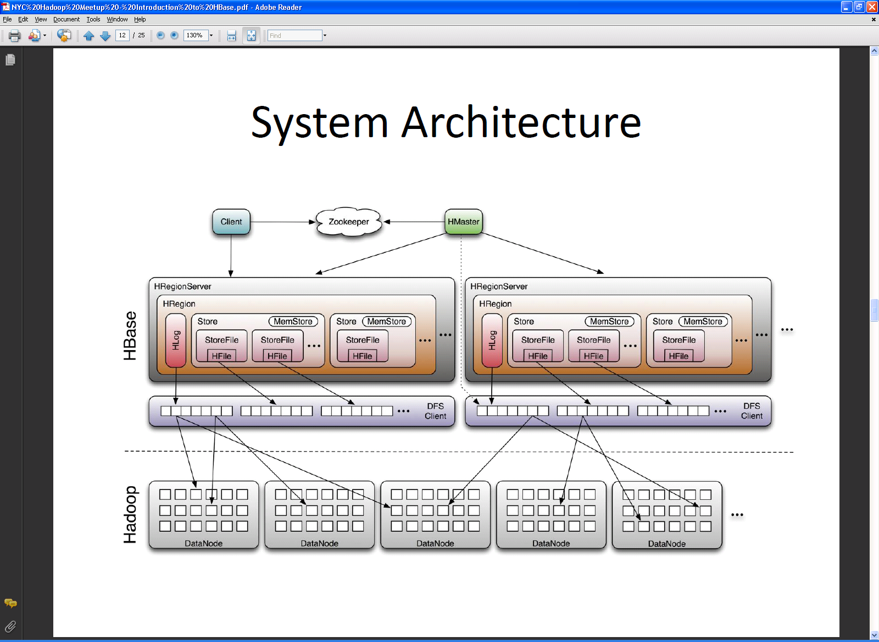
HBase System Architecture
From http://www.larsgeorge.com/2009/10/hbase-architecture-101-storage.html

Slide 39
HBase Master manages region servers

Slide 40
Hbase Client directly access region servers for data

Slide 41
HBase Demo
HBase shell
HBase API

Slide 42
The Apache stack of open source software – Hive
Workflow
(Cascading / Azkaban)
Data Ingest
(Flume)
Solr / Lucene
Zookeeper
Pig
Hive
HBase
Map / Reduce
HDFS
Notes:
The foundation of the entire system is HDFS – almost everything uses that to store data
M/R distributes tasks across the cluster and provides for parallel execution under a particular restrictive model of computation
HBase stores all data in HDFS, but it also aggressively caches values in memory so it can be used as a real-time store of data – StumbleUpon uses it in their live web site.
Hive is an SQL –like data store. We use it at the lab but not as part of our text analysis. But it makes the transition from Oracle much less painful
Pig is a higher level data flow language. Its operations are implemented as M/R jobs underneath the covers, allowing developers to abstract away from that portion
Zookeeper is the main member of the Hadoop family that is not based on HDFS. It is a highly performant, in-memory, transactional datastore. Typically used to ensure high-availability of different components. It does all of the heavy lifting for distributed systems.
Katta and Solr/Lucene provide the distributed text search capability.
The missing puzzle piece is a full workflow management system. However, Linked in is currently working on a system they call Project Voldemort that they intend to release open-source in the next couple of months.

Slide 43
Hive provides and SQL-like interface to data
Components
Shell: SQL-like command line; Web; JDBC
Driver: API interface
Compiler: parse, plan, optimize
Execution Engine: DAG of stages (M/R, HDFS, or metadata)
Metastore: schema, location in HDFS, SerDe
HCatalog aims to provide Hive metadata as a global service
http://www.cloudera.com/videos/introduction_to_hive
Notes:
One of the big benefits to Hive over hbase is the ability to do joins between tables
Not ideal as an oracle replacement: queries are relatively slow on small data; doesn’t conform to standards; isn’t really transactional
Allows extensions for m/r tasks that are not part of the language

Slide 44
The Apache stack of open source software – Solr / Lucene
Workflow
(Cascading / Azkaban)
Data Ingest
(Flume)
Solr / Lucene
Zookeeper
Pig
Hive
HBase
Map / Reduce
HDFS
Notes:
The foundation of the entire system is HDFS – almost everything uses that to store data
M/R distributes tasks across the cluster and provides for parallel execution under a particular restrictive model of computation
HBase stores all data in HDFS, but it also aggressively caches values in memory so it can be used as a real-time store of data – StumbleUpon uses it in their live web site.
Hive is an SQL –like data store. We use it at the lab but not as part of our text analysis. But it makes the transition from Oracle much less painful
Pig is a higher level data flow language. Its operations are implemented as M/R jobs underneath the covers, allowing developers to abstract away from that portion
Zookeeper is the main member of the Hadoop family that is not based on HDFS. It is a highly performant, in-memory, transactional datastore. Typically used to ensure high-availability of different components. It does all of the heavy lifting for distributed systems.
Katta and Solr/Lucene provide the distributed text search capability.
The missing puzzle piece is a full workflow management system. However, Linked in is currently working on a system they call Project Voldemort that they intend to release open-source in the next couple of months.

Slide 45
Solr
Faceted text search interface built on top of Lucene
Built as a native web app – drops into any web server
Elastic Search is a Lucene extension similar to Solr, but built for cluster access
Notes:
Fantastic for text searching
Supports multiple langue
Supports different facet types (dates, numbers, strings); hierarchy is supported through an ugly hack
Does not require the full index to be in memory, but is very slow if index is not in memory
Supports replication and sharding, but does not make it easy

Slide 46
Solr architecture
Diagram by Yonik Seeley
Admin Interface
HTTP Request Servlet
Update Servlet
Standard Request Handler
Disjunction Max Request Handler
Custom Request Handler
XML Response Writer
XML Update Interface
Solr Core
Update Handler
Config
Schema
Caching
Replication
Analysis
Concurrency
Lucene

Slide 47
Solr Cloud provides faceted search and scalability
Shard A
Node 1
4) Shard results
…
3) Forward Q. to shards
Text search interface
Shard Z
1) Query
…
4) Shard results
3) Forward Q. to shards
Shard A
Node n
5) Combined Results
…
Solr
2) Request shard info
Shard Z
Zookeeper
Notes:
Using katta takes care of replicating shards.
Katta does not generate shards – you have to do that separately, but this is straightforward to use an HBase table to generate a shard set from
Manages copying shards from a shared location (like hdfs) out to a local directory on all of the nodes. Manages the replication
Uses zookeeper to maintain the current state of where shards are so queries can be round-robinned between replicas, or simply split and joined for single shards

Slide 48
Architecture is nice, but where are the analytics?

Slide 49
Data Analytics
High value keywords
Named entities
Relationships
Latent Topics (LDA, NMF, etc.)
Clustering
Classification
Recommendation

Slide 50
Notional Data Flow for Text Analytics
Initial Load
Load original documents system
Parse
Extract text and meta data
Local Analytics
Named Entity Extraction (SNER)
Parsing / Coreference
Global Analytics
Send corpus slices to LDA for topic modeling
Index
Create data structures for quick access
Serve
Respond to user requests

Slide 51
Anatomy of the code
Reconcile (coreference resolution software developed at Utah, Cornell, and LLNL)
Reconcile-hbase (connecting reconcile with HBase – code from LLNL)
Stanford NLP
Tokenization
Sentence splitting
Part of Speech tagging
Named entity resolution
Semantic dependency parse
Deterministic coreference

Slide 52
Reconcile defines the basic data structures
Document
Original data
Raw text extracted from document
Meta-data extracted from document
Annotations over document
byte offsets into raw text
Attributes of byte offset spans
Corpus
Collection of documents
Mostly useful for local file system centric experiments

Slide 53
Reconcile-hbase generalizes the code to the cluster
Defines an explicit table schema for document collections
column families
text: stores the original and raw text
src: information related to the source of the document
Legacy and should likely be merged with text
meta: metadata extracted from the document
annotation: bytespan offsets
Schema is encapsulated in DocSchema class for reference
Also has convenience functions
Create table
Extracting data from a row
Placing data into a row

Slide 54
Query functions
HBase shell
has Ruby syntax
Only executes serially
Common questions answered by M/R queries
How many rows are in a table?
What column names are used in a column family?
What is the distribution of values in a column?
Designed for low cardinality columns
What are the size of the rows / column families in my table?

Slide 55
Reconcile-HBase Software deficiencies
Too many column families (src, meta, and text could be combined)
Doesn’t use JSON as the annotation format
…

Slide 56
Software
Reconcile
reconcile.sourceforge.net
github.com/davidbuttler/reconcile-data
github.com/davidbuttler/reconcile-features
Reconcile-HBase
github.com/davidbuttler/reconcile-hbase
github.com/davidbuttler/reconcile-hbase-annotations
github.com/davidbuttler/ant-maven-build
Stanford Core NLP
nlp.stanford.edu/software/corenlp.shtml

Slide 57
Software dependencies (ex Apache commons)
Lucene (2.93)
Solr (1.5 branched)
Rome (0.9)
Findbugs (1.0.0)
Guava (r06)
Gson (1.4)
Hadoop 0.20.2-cloudera-320
HBase (0.90.3)
jwnl (1.4_rc3, modified)
openNLP
MSTParser
Berkley Parser
Reconcile only

